Slide 1
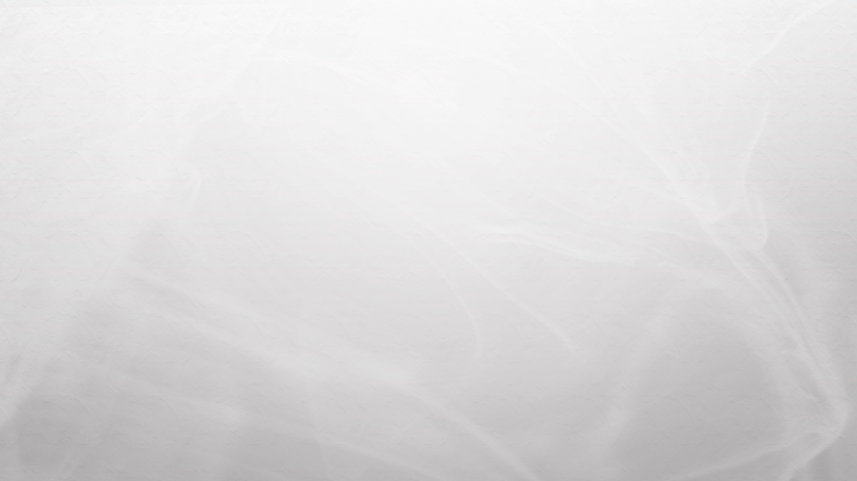

Sensory Overload
Controlling an Arduino from a UWP app

Slide 2
Resources
Online Arduino sketch editor - https://create.arduino.cc
Firmata Protocol - https://github.com/firmata/protocol
Windows Remote Arduino - https://github.com/ms-iot/remote-wiring
Source Code - https://github.com/brentestewart/UWP_to_Arduino

